Slide 1
SUBMITTED IN PARTIAL FULFILLMENT OF THE REQUIREMENT FOR Four Weeks Training at KERALA BLOCKCHAIN ACADEMY ( from 1 Aug to 30 Aug )
BLOCKCHAIN
SUBMITTED BY
SHASHI GUPTA
D4ITB1
1821072 , 1805555

Slide 2
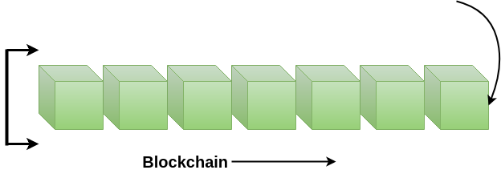
INTRODUCTION
Blockchain is an emerging technology platform for developing decentralized applications and data storage, over and beyond its role as the technology underlying the cryptocurrencies. The basic tenet of this platform is that it allows one to create a distributed and replicated ledger of events, transactions, and data generated through various IT processes with strong cryptographic guarantees of tamper resistance, immutability, and verifiability. Public blockchain platforms allow us to guarantee these properties with overwhelming probabilities even when untrusted users are participants of distributed applications with ability to transact on the platform. Even though, blockchain technology has become popularly known because of its use in the implementation of Cryptocurrencies such as BitCoin, Ethereum, etc.

Slide 3
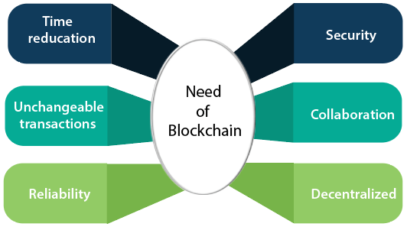

Slide 4

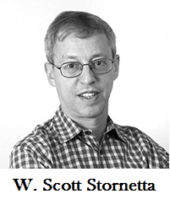
HISTORY OF BLOCKCHAIN
The blockchain technology was described in 1991 by the research scientist Stuart Haber and W. Scott Stornetta. They wanted to introduce a computationally practical solution for time-stamping digital documents so that they could not be backdated or tampered. They develop a system using the concept of cryptographically secured chain of blocks to store the time-stamped documents.

Slide 5
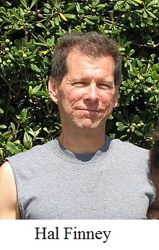
In 2004, computer scientist and cryptographic activist Hal Finney introduced a system called Reusable Proof Of Work(RPoW) as a prototype for digital cash. It was a significant early step in the history of cryptocurrencies. The RPoW system worked by receiving a non-exchangeable or a non-fungible Hashcash based proof of work token in return, created an RSA-signed token that further could be transferred from person to person.
RPoW solved the double-spending problem by keeping the ownership of tokens registered on a trusted server. This server was designed to allow users throughout the world to verify its correctness and integrity in real-time.

Slide 6
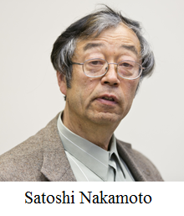
Further, in 2008, Satoshi Nakamoto conceptualized the theory of distributed blockchains. He improves the design in a unique way to add blocks to the initial chain without requiring them to be signed by trusted parties. The modified trees would contain a secure history of data exchanges. It utilizes a peer-to-peer network for timestamping and verifying each exchange. It could be managed autonomously without requiring a central authority. These improvements were so beneficial that makes blockchains as the backbone of cryptocurrencies. Today, the design serves as the public ledger for all transactions in the cryptocurrency space.

Slide 7
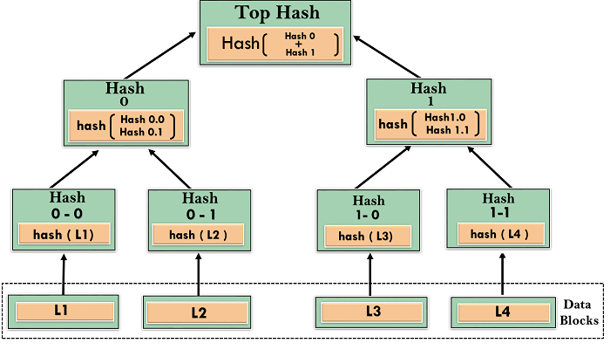
Merkle Trees
A Merkle tree stores all the transactions in a block by producing a digital fingerprint of the entire set of transactions. It allows the user to verify whether a transaction can be included in a block or not.
Merkle trees are created by repeatedly calculating hashing pairs of nodes until there is only one hash left. This hash is called the Merkle Root, or the Root Hash. The Merkle Trees are constructed in a bottom-up approach.

Slide 8

BITCOIN
Satoshi Nakamoto introduced the bitcoin in the year 2008. Bitcoin is a cryptocurrency(virtual currency), or a digital currency that uses rules of cryptography for regulation and generation of units of currency. A Bitcoin fell under the scope of cryptocurrency and became the first and most valuable among them. It is commonly called decentralized digital currency.
A bitcoin is different from other traditional currencies such as Dollar, Pound, and Euro, which can also be used to buy things and exchange values electronically. There are no physical coins for bitcoins or paper bills. When you send bitcoin to someone or used bitcoin to buy anything, you don?t need to use a bank, a credit card, or any other third-party. Instead, you can simply send bitcoin directly to another party over the internet with securely and almost instantly.

Slide 9

INTRODUCTION TO ETHEREUM
Ethereum is often referred to as the second most popular cryptocurrency, after Bitcoin. But unlike Bitcoin—and most other virtual currencies—Ethereum is intended to be much more than simply a medium of exchange or a store of value. Instead, Ethereum calls itself a decentralized computing network built on blockchain technology

Slide 10
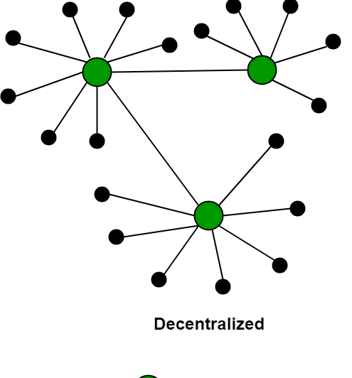
DECENTERLIZATION
In the blockchain, decentralization alludes to the transfer of supervision and decision-making from a centralized association (individual, corporation, or group of people) to a dispersed network. Decentralized networks endeavor to decrease the degree of trust that members should put in each other and dissuade their capacity to put forth authority or command over each other in manners that corrupt the potency of the network.

Slide 11
List the key features of blockchain?
Decentralized Systems
Distributed ledger
Safer & Secure Ecosystem
Fast
Low Transaction Fees

Slide 12
CURRENT IMPLETATION
Blockchain in Digital Advertising
Blockchain in Cyber Security
Blockchain will remove the requirement of the third party
Governments will provide their digital currencie
Managing World trade with the help of Blockchain Technology
Use of Blockchain in the Internet of Things and Networking
Blockchain in cloud storage

Slide 13
Conclusion:
The application of Blockchain technology is not limited only to the finance industry. It has a fantastic future in different sectors such as supply chain management, digital advertising, forecasting, cyber security, Internet of things, networking, etc. Blockchain technology also has a huge prospective to provide the new openings for occupation in the industry. It also enhances the professional’s capability to upgrade themselves. With the help of Blockchain technology, it is possible to transform the whole world into a much smaller place. The transactional activities can be performed much faster and efficiently using Blockchain. Blockchain technology is going to be used in many more sectors in the future such as in government systems as these systems are slow, dense, and likely to corruption. Implementing Blockchain technology in government system can make their operations much more secure and efficient

Slide 14
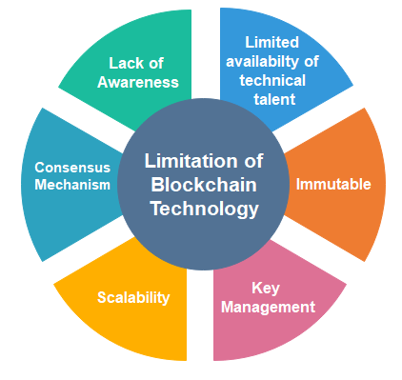

Slide 15
THANK
YOU

